Slide 1
REMOTE MONITORING OF PERISHABLE GOODS USING IOT

Slide 2
ABSTRACT
The main reason for “Remote Monitoring Of Perishable Goods Using lot ” is improper temperature control.
It is a key reason for why medicines like vaccinations and other perishable goods are wasted in the supply chain.
Even the slight change(increase) in temperature while handling Products can lead to deterioration, considerable loss in revenue.
To avoid this a cold chain must be established and maintained to ensure goods have been properly refrigerated during every step of the process, making temperature monitoring and also can be alerted the user when over any fire accidents occurs.

Slide 3
FEATURES
Ensure temperature stays within the acceptable range by using the sensors.
Alerts are triggered when the temperature is not at optimal degrees.
Admin can continuously monitor the temperature conditions of that particular area and also can be alerted when any fire accidents occur.
Automatic controlling of AC according to temperatures to maintain the optimal conditions
Some perishable goods like medicines or vaccines should be stored in proper temperatures.

Slide 4
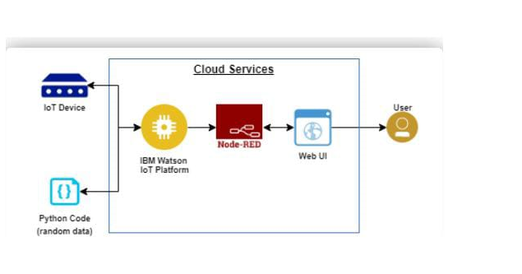
BLOCK DIAGRAM

Slide 5
IMPLEMENTATION TOOLS REQUIRED
IBM cloud platform
IBM Watson
IOT application development
Python programming language
Node Red editor

Slide 6
PYTHON CODE
#IBM Watson IOT Platform
#pip install wiotp-sdk
import wiotp.sdk.device
import time
import random
myConfig = {
"identity": {
"orgId": "hj5fmy",
"typeId": "NodeMCU",
"deviceId":"12345"
},
"auth": {
"token": "12345678"
}
}

Slide 7
def myCommandCallback(cmd):
print("Message received from IBM IoT Platform: %s" % cmd.data['command'])
m=cmd.data['command']
client = wiotp.sdk.device.DeviceClient(config=myConfig, logHandlers=None)
client.connect()
while True:
temp=random.randint(-20,125)
hum=random.randint(0,100)
myData={'temperature':temp, 'humidity':hum}
client.publishEvent(eventId="status", msgFormat="json", data=myData, qos=0, onPublish=None)
print("Published data Successfully: %s", myData)
client.commandCallback = myCommandCallback
time.sleep(2)
client.disconnect()

Slide 8
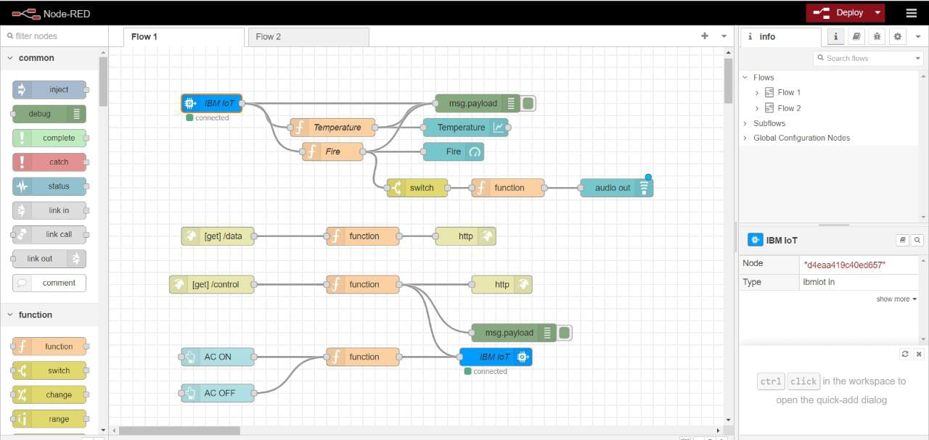
NODE RED FLOW

Slide 9
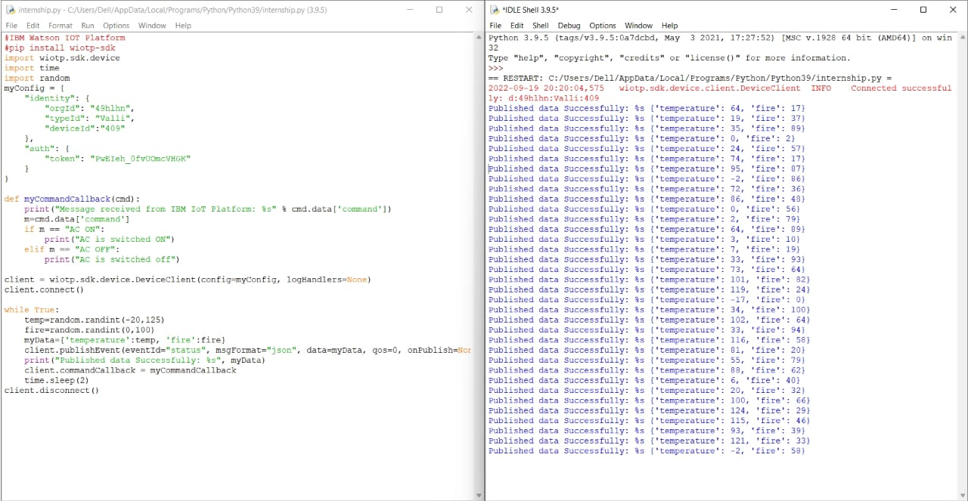
RESULTS

Slide 10
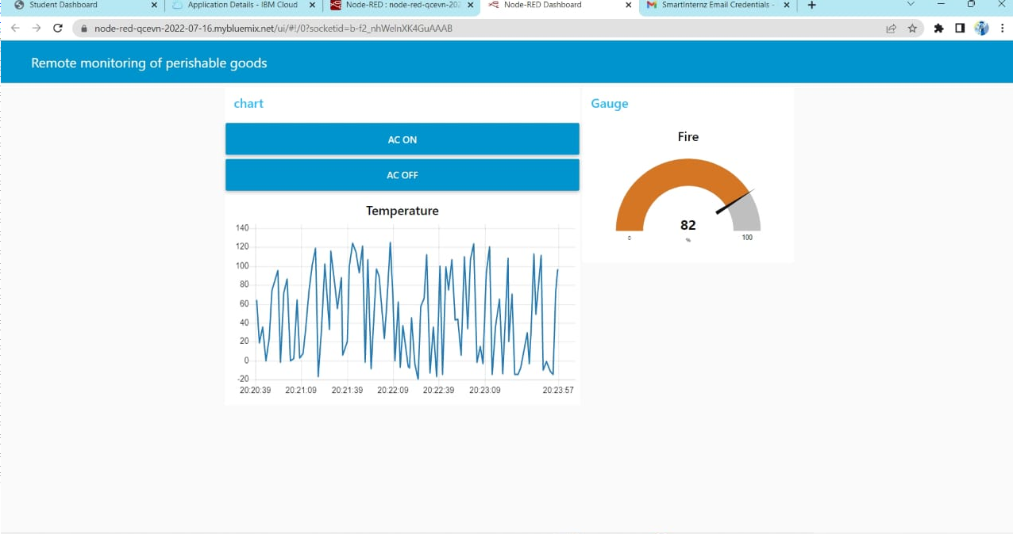

Slide 11
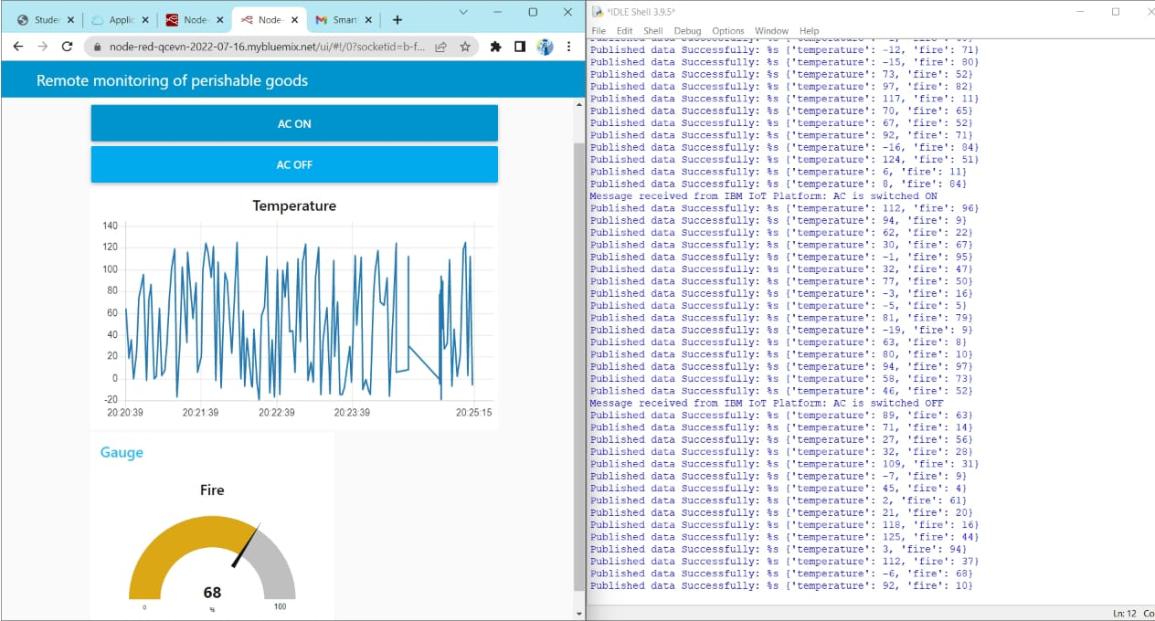

Slide 12
ADVANTAGES
Minimize human effort: As IoT devices interact and communicate with each other, they can automate the tasks helping to improve the quality of a business’s services and reducing the need for human intervention.
Enhanced data collection: Information is easily accessible, even if we are far away from our actual location, and it is updated frequently in real-time. Hence these devices can access information from anywhere at any time on any device.
Improved security: If we have an interconnected system, it can assist in the smarter control of homes and cities through mobile phones. It enhances security and offers personal protection.

Slide 13
ADVANTAGES
Efficient resource utilization:We can increase resource utilization and monitor natural resources by knowing the functionality and how each device works.
Reduced use of other electronic equipment: Electric devices are directly connected and can communicate with a controller computer, such as a mobile phone, resulting in efficient electricity use. Hence, there will be no unnecessary use of electrical equipment.
Use in traffic systems: Asset tracking, delivery, surveillance, traffic or transportation tracking, inventory control, individual order tracking, and customer management can be more cost-effective with the right tracking system using IoT technology.

Slide 14
ADVANTAGES
Useful in the healthcare industry: Patient care can be performed more effectively in real-time without needing a doctor’s visit. It gives them the ability to make choices as well as provide evidence-based care.
Save time: By reducing the human effort, it saves a lot of our time. Saving time is one of the primary advantages of using the IoT platform.
Useful for safety concerns: It is helpful for safety because it senses any potential danger and warns users. For example, GM OnStar is an integrated device that identifies a car crash or accident on the road. It immediately makes a call if an accident or crash is found.

Slide 15
DISADVANTAGES
Security issues: IoT systems are interconnected and communicate over networks. So, the system offers little control despite any security measures, and it can lead to various kinds of network attacks.
Privacy concern: The IoT system provides critical personal data in full detail without the user’s active participation.
Increased unemployment: Unskilled workers or even the skilled ones are at a high risk of losing their jobs, leading to high unemployment rates. Smart surveillance cameras, robots, smart ironing systems, smart washing machines, and other facilities are replacing the humans who would earlier do these works.
The complexity of the system: The designing, developing, maintaining, and enabling the extensive technology to IoT system is quite complicated.

Slide 16
DISADVANTAGES
High chances of the entire system getting corrupted: If there is a bug in the system, it is possible that every connected device will become corrupted.
Lack of international standardizations: As there is no international standard of compatibility for IoT, it is problematic for devices from different manufacturers to communicate with each other.
High dependency on the internet: They rely heavily on the internet and cannot function effectively without it.
Reduced mental and physical activity: Overuse of the internet and technology makes people ignorant because they rely on smart devices instead of doing physical work, causing them to become lethargic and inactive.

Slide 17
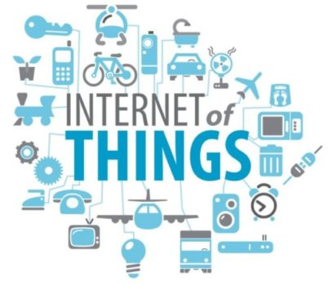
APPLICATIONS
Smart City.
Smart Home.
Smart Self-Driving Cars.
IoT in Farming.
Fitness Trackers.
IoT-Connected Factories.
IoT Hospitality and Tourism.
Retail IoT.
Smart Grid

Slide 18
CONCLUSION
Remote monitoring of perishable goods plays important role in countries economy and human health, here the observations show that fused data provide accurate decision to the prevailing condition. The fused data was safely stored and made available to authorized users.
The system incorporated with information fusion is connected with cloud platform and was used for perishable goods quality monitoring continously.

